Slide 1
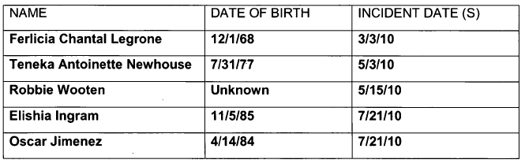
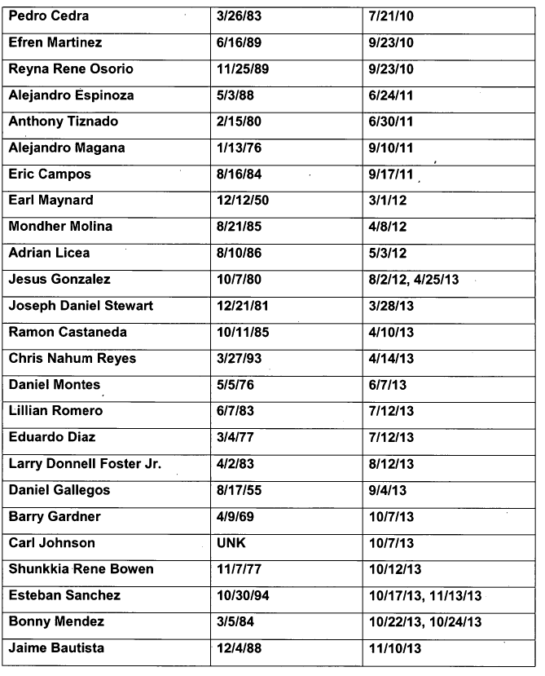

Slide 2
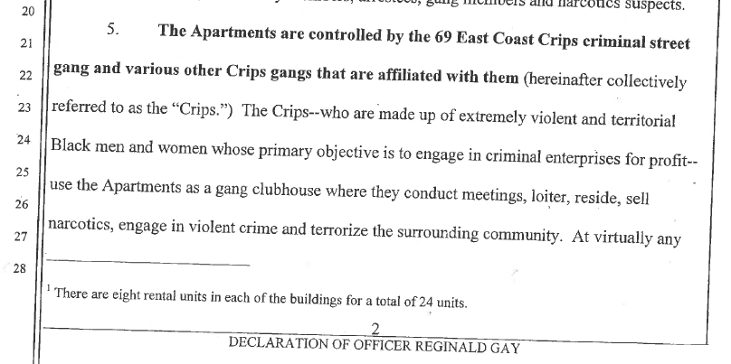

Slide 3
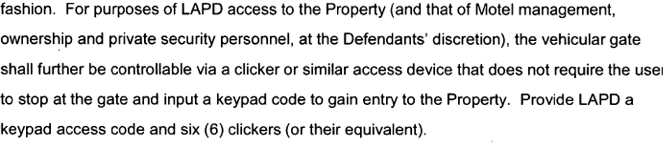

Slide 4
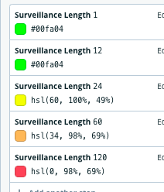
% Black and Latinx
Years of Surveillance
0-25%
< 2 years
25 - 50%
2 - 5 years
50 - 75%
25 - 10 years
75 - 100%
> 10 years
CNAP Cases
Sold Once
CNAP Cases
Sold Once
Sold Twice

Slide 5
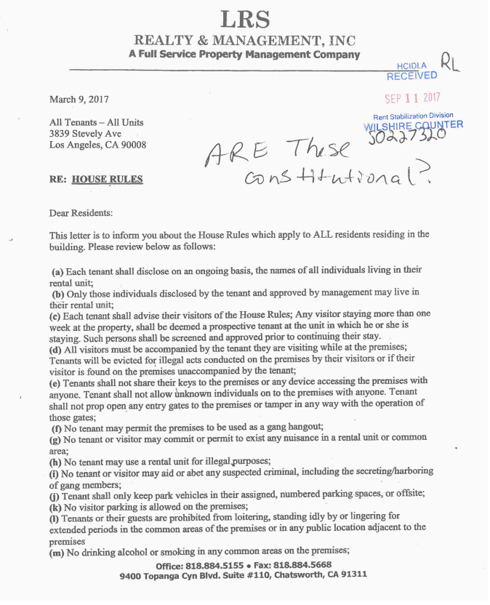

Slide 6
